Slide 1
RAG
Akshay Parate

Slide 2
What is RAG ?
RAG which stands for Retrieval Augmented Generation, is a technique that enhances the accuracy and relevance of responses generated by large language models (LLMs) by allowing them to access and incorporate information from external knowledge bases, essentially providing more up-to-date and context-specific answers to queries.
Benefits:
Improved accuracy
Domain-specific expertise
Up-to-date information
Applications:
Customer service chatbots
Knowledge management systems
Research and analysis

Slide 3
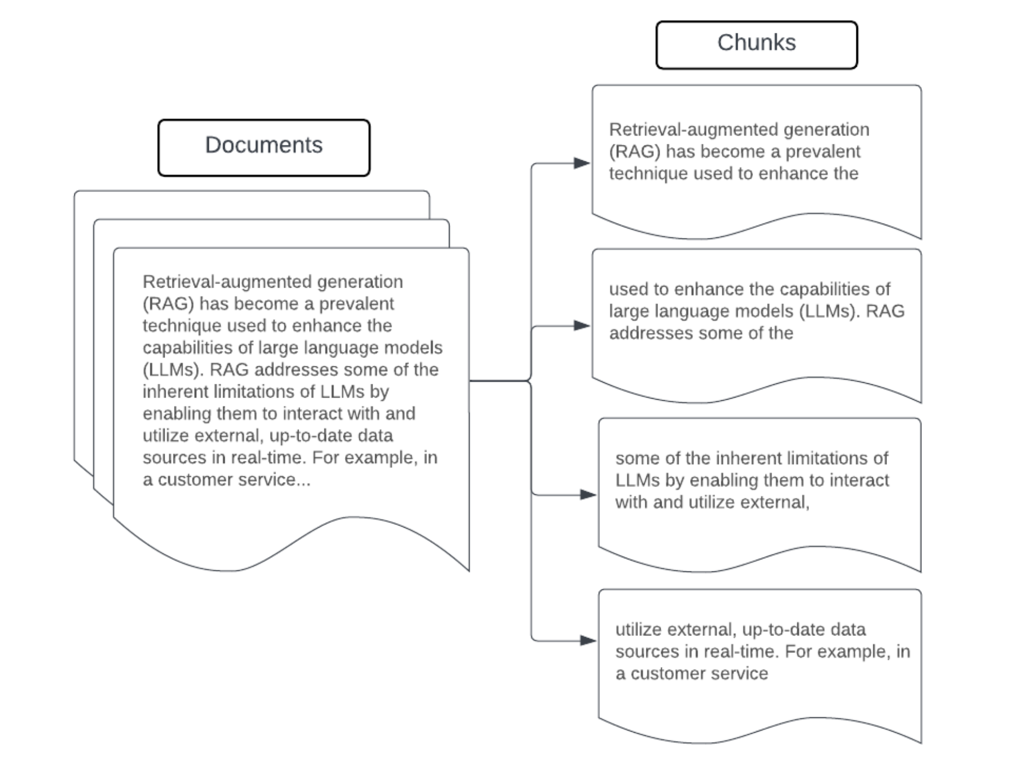
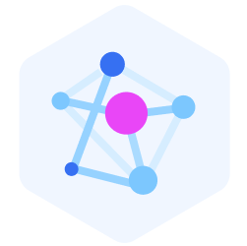

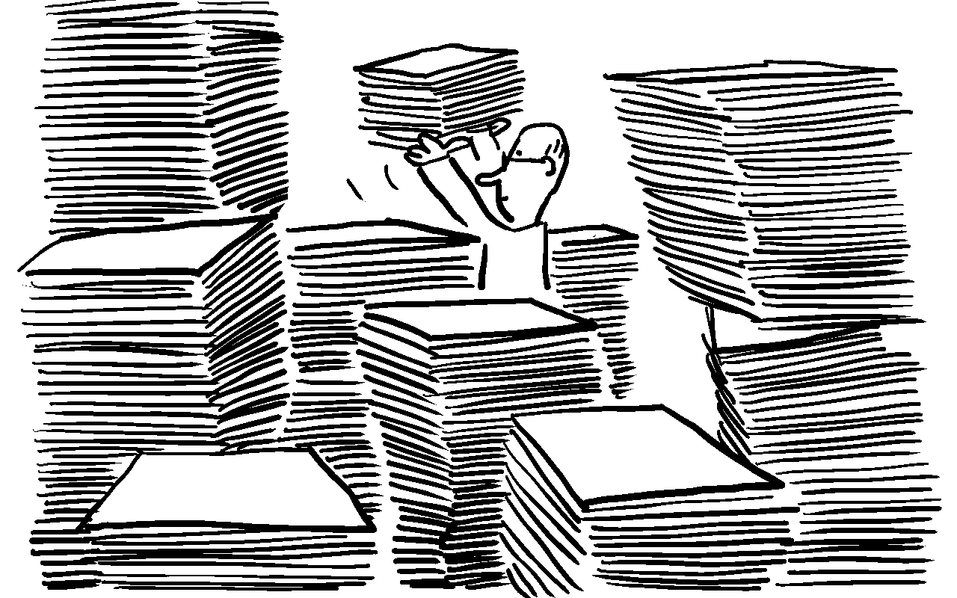

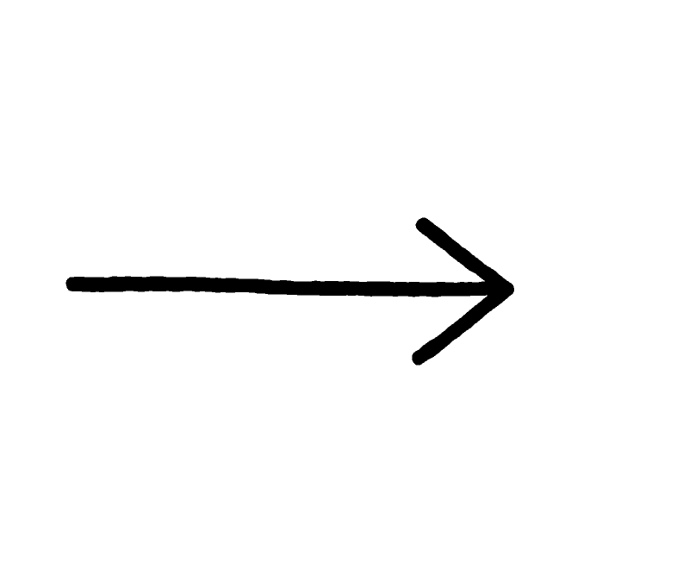
How the RAG Ingestion pipeline works?
Tons of unstructured data
Chunks of data
Vector Embeddings
Vector Database

Slide 4
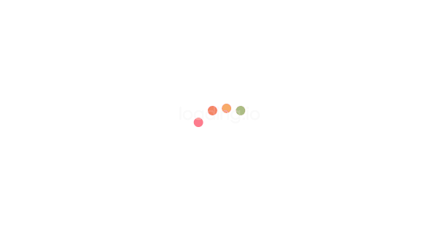



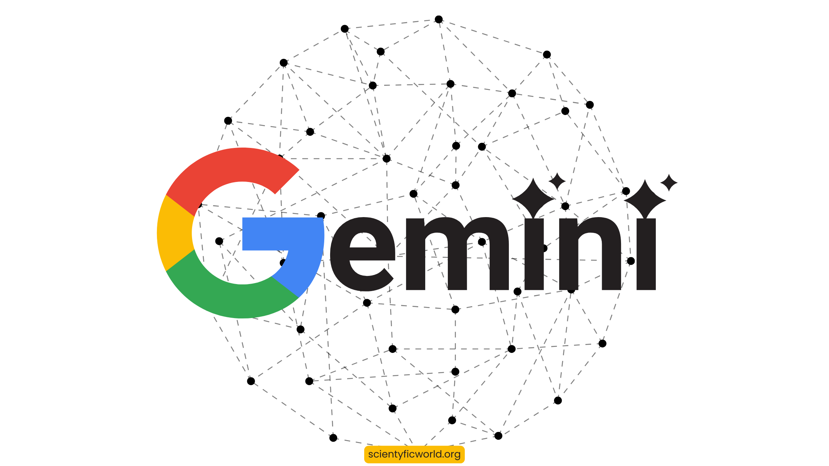
How the RAG Retrieval pipeline works?
User Query
Embedding Models
Vector Database
Perfect
Answer
LLM
K Documents

Slide 5

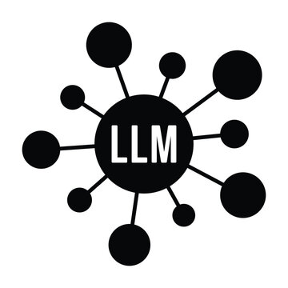

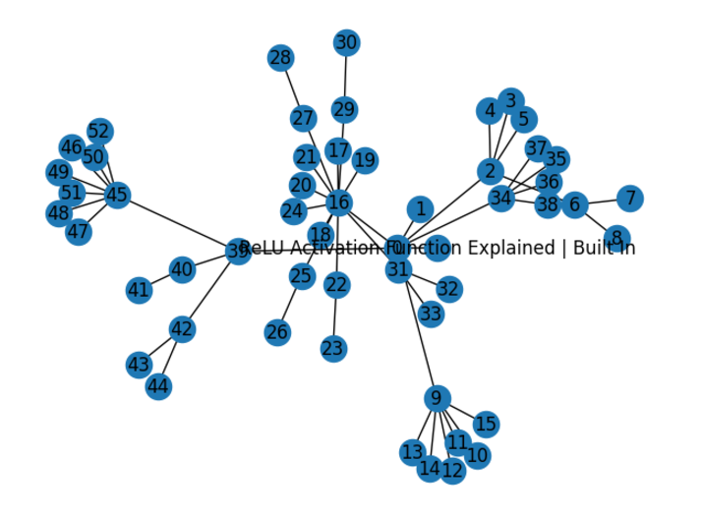
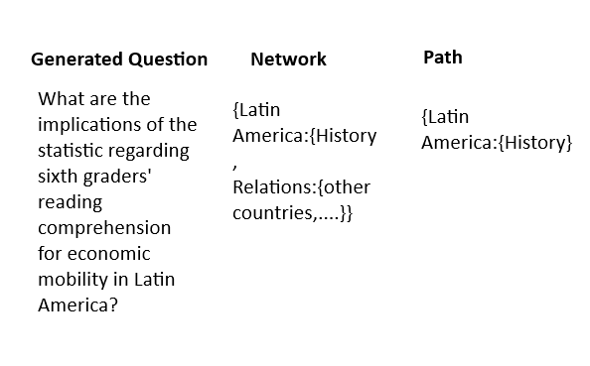
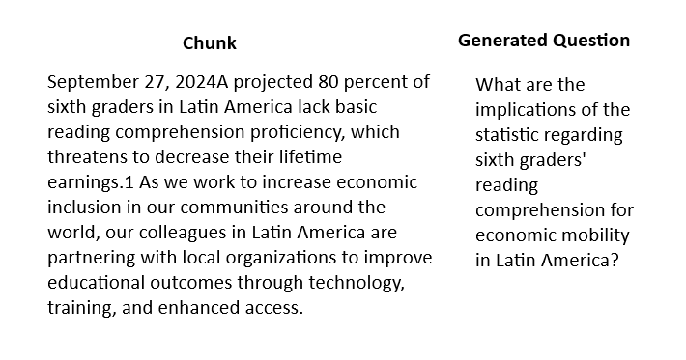

REALM : Retrieval Augmented Language Model
Data Generation
Web Crawler
Network Graph
LLM
Transformation

Slide 6
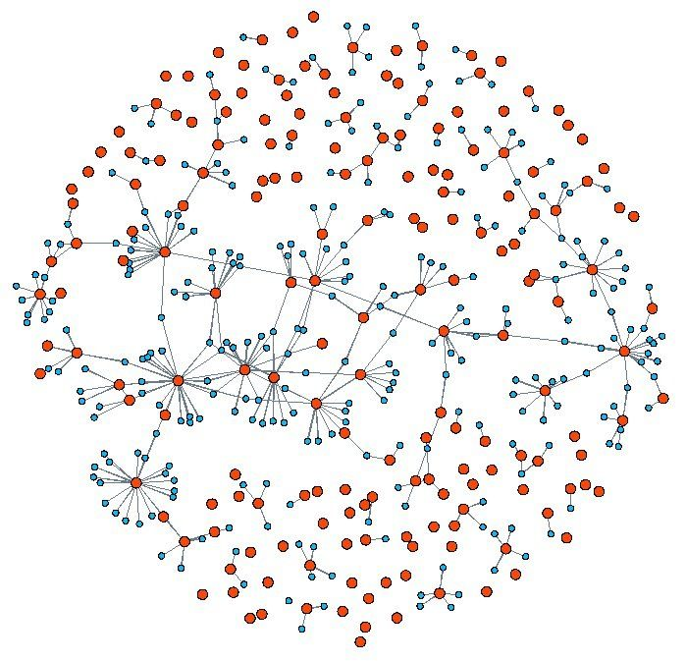
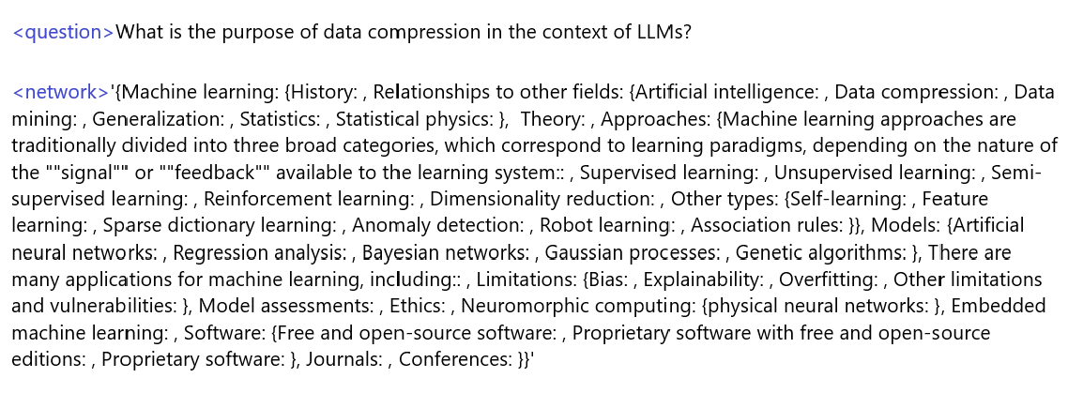


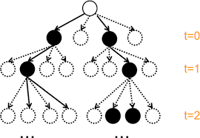
RAPTOR : Recursive Abstractive for Tree Organized Retrieval
PDF/Website
Network Graph
User Query + Network
'Machine learning->Relationships to other fields->Data compression'
Path Predictions
REALM

Slide 7
Advantages Over Vanilla RAG
Context Tracking and Detailed Explanations : Graph/tree-like structure ensures seamless context retention and enables comprehensive explanations without skipping topics (common in Vanilla RAG).
Multimodal Context Awareness : Tracks and integrates code or images within the document enhances explanations, akin to an interactive video experience.
Reduced Hallucination : Improves factual accuracy by leveraging structured context and reducing reliance on assumptions.
Enhanced Scalability : Efficiently handles large and complex datasets with better organization and retrieval capabilities.
Improved Query Understanding : Adapts to user-specific queries by dynamically navigating the graph structure for tailored responses.

